Slide 1
Slough Learning Disability Partnership Board

Slide 2
Hello and welcome!
Slough Learning Disability Partnership Board
Giuseppe Di Martino
LD and Autism Commissioner

Slide 3
What is it for
Slough Learning Disability Partnership Board
The Slough Learning Disability Partnership Board wants to improve the lives of people with a learning disability, their families, and carers by challenging inequalities, influencing decisions about services, and preventing the need for specialised support.

Slide 4
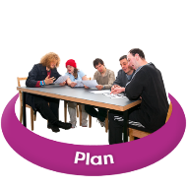
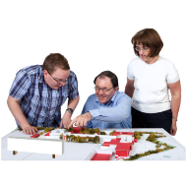
What the learning disability partnership board does
Slough Learning Disability Partnership Board
Oversees the Action Plan included in the Adult Learning Disability Strategy
Ensures Co-Production becomes the normal and expected way of working.
Makes sure learning disability services are of good quality.
Makes recommendations and influence decisions about services.
Creates and shares information in accessible format.
Informs people about what is happening in Slough.
Promotes the rights of people with learning disability, their families, and carers.

Slide 5
What do you want
Slough Learning Disability Partnership Board
For a successful Learning Disability Partnership Board that can bring about change, it is important that all the right people are members.
We want to hear what people with learning disability, their families and carers want, so we would like to invite them to join the group.
By joining, you will help shape the future of Learning Disability Services in Slough.
Other members include professionals working in health and social care and other relevant services (housing, DWP, etc).

Slide 6
Rules To Participate:
Slough Learning Disability Partnership Board
Attend at least two meetings per year.
Using simple language, no jargon.
Respect other people’s ideas
Be kind to others.
Work as a team.
Maintain confidentiality.

Slide 7
Support for members
Slough Learning Disability Partnership Board
The Slough Learning Disability Partnership Board will meet once every three months
Members will be supported during meetings by:
Ensuring they have a voice.
Using simple language, no jargon.
Extra time after the meetings to discuss specific topics.
Notes of the meetings will be published in easy read format.

Slide 8
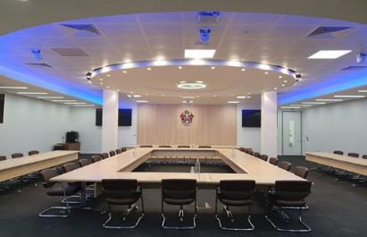
First Meeting:
Slough Learning Disability Partnership Board
21st February 2024
11:00 am – 1:00 pm
Council Chambers
Observatory House
25 Windsor Road
Slough
SL1 2EL
From
To

Slide 9
Get Involved:
Slough Learning Disability Partnership Board
For more information or how to participate contact Slough Borough Council Co-Production Network
BeInvolved@slough.gov.uk

Slide 10
Thank You

