Slide 1
Generating hope Slough’s Anchor programme
Notes:
The pandemic highlighted and renewed the focus on addressing racial inequalities.
Regional response – Turning the Tide Transformation programme
National response – 6 EDI actions
Accumulation of recommendations over decades
Snowy white peaks – Roger Kline
McPherson enquiry
Recent reports confirm we still have more to do
Failure to name racism and other forms of discrimination - prevents meaningful action being taken to address these structural and institutional barriers (HOLDING UP A MIRROR TO CRICKET A Report by the Independent Commission for Equity in Cricket)
Casey review – racism still exists in police
It’s the Right thing to do
Amanda Pritchard apology to Michelle Cox
XX case recently highlighted

Slide 2
What is Anchor?
An opportunity to use the collective power of large, local employers to address the socio-economic factors that lead to inequalities in health.
Employment Opportunities
Sustainability
Professional development
Procurement
Health, Housing, estates and land use

Slide 3
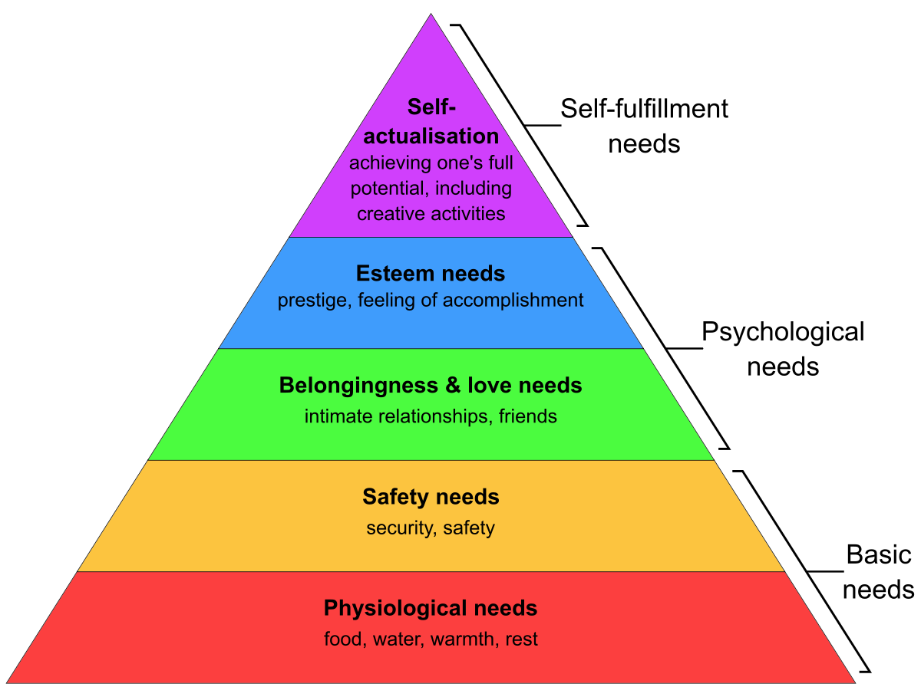
The drivers behind Anchor
Good Work - The Taylor review of modern working practices (July 2017)
The review confirms that while having employment is vital to people’s health and well-being, the quality of people’s work is also a major factor in helping people to stay healthy and happy, something which benefits them and serves the wider public interest.
Berkshire, A good place to work, Director of Public Health report (2019)
Highlights the benefits of Anchor and emphasises that the benefits of employing individuals from a range of different backgrounds and abilities should not be underestimated.
National ICS People function guidance (August 2021)
Confirms that the ICS people function has a role in ensuring that the health and wellbeing of the local population is considered in planning and to support sustainable development of anchor networks.
In the context of Maslow's hierarchy, we can see that
access to a meaningful job with opportunities for career progression can support an increased sense of belonging, improve self-esteem and enable self-actualisation.
NHS Long Term Workforce plan (July 2023)
Anchors provide an opportunity to add social value, benefit communities and reduce inequalities through direct employment practices.
This can be achieved by:
recruiting more people from local communities with a particular focus on those who may experience health inequalities
proactively facilitating skills development including digital skills, career progression and social mobility programmes
supporting the health and wellbeing of all staff
(also part of High Impact Action 4 – NHS EDI Improvement plan)

Slide 4
Slough – data headlines on a page
Five largest industries in Slough
Wholesale and Retail Trade: Repair of vehicle and motorcycles
Human, Health and Social Work Activities
Transportation and Storage
Information and Communication
Education
Socio-economic inequalities
More deprived than the South East average
Higher proportion of people claiming unemployment benefit than the South East and England averages.
Areas with the most need: Britwell/ Chalvey/ Wexham Lea/ Colnbrook/ Poyle
Age – young population
25% of Slough’s residents are aged 0-15, 65.4% are aged 16-64, and 9.7% are aged 65 or over.
Average age is 34, compared to 41 in South East and 40 for England.
-Second highest proportion of children aged 15 or under in England and Wales.
Ethnicity
46.7% - Asian ethnic Groups
36% from White ethnic groups
7.6% Black Ethnic Groups
4.5% Other ethnic
4% Mixed Ethnic
High proportion of groups from Pakistani/ Indian origin
Sexual orientation & gender identity
1.9% of Slough’s population identified as an LGB+ orientation (lower than the England average of 3.2%).
0.9% of Slough’s population identified as a different gender to their sex registered at birth (same as the England average).

Slide 5
Anchor Institutions – Slough Place
Ways of Working
5 elements of the Anchor Employment Strategy
Co-production with the people who will benefit from the programme (nothing about us, without us)
Learn from, build on, and enhance existing programmes
Influence commissioning and supply chains
Generate a sustainable strategy with collective ownership of leaders in health, social care, local government and local employers.
People who are seeking employment or more stable roles. [Disability, Neurodivergence, Refugees, people living in areas of ‘deprivation’.]
Employers with hard to fill roles, vacancies and skills gaps
Organisations that support education and skills development – Frimley Academy, Langley College, Skills for Care
Operational teams that support people to access employment – Ability Slough, Skills Hub (the Curve), Recruitment leads (NHS, Commercial)
Organisational development, Culture, Health and Wellbeing specialists.

Slide 6
Next steps and timescales

